Slide 1
Andrew Skeels, Bailey Dawson, Malaysia Joseph, Naeun Shim, Claudia Mora

Slide 2
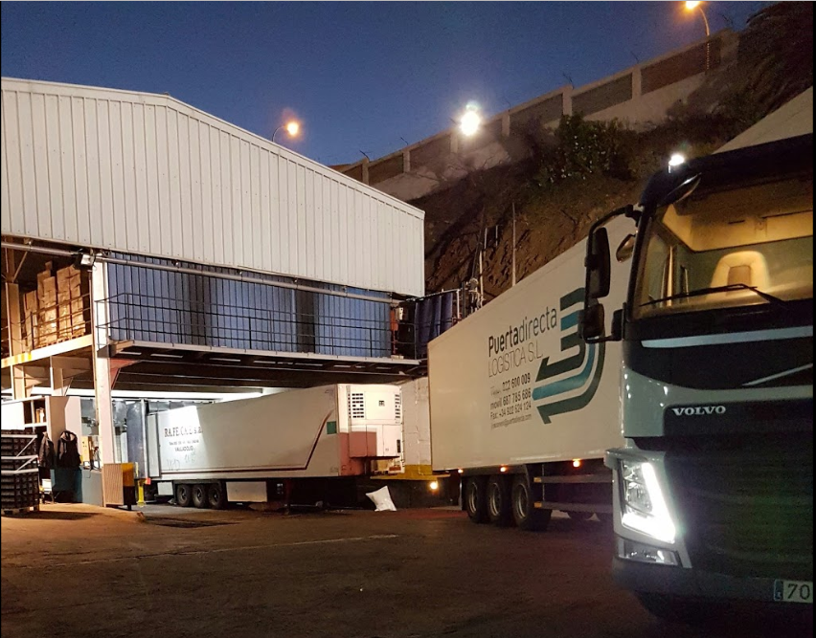
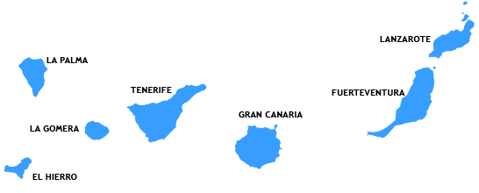
What is Puerta Directa?
Puerta Directa is a private packaging business
Delivers personal and commercial packages
Operates in the Canary Islands
Notes:
Puerta Directa is a private packaging business- kind of like FedEx or UPS
Delivers personal and commercial packages- from large quantities of supermarket products, to small personal items.
Operates in the Canary Islands- set of islands in spain.

Slide 3
Original Problem
Two Main Issues:
Company has archaic system of tracking Trucks and keeping up to date with their inspections.
Also, there is no record of which employee would drive each truck because Trucks and Employees are randomly assigned to each other.
So when an Employee does damage to a Truck, there is no way of knowing who it was unless they admit it.

Slide 4
Original Problem (Cont.)
Consequences of lack of tracking systems for Inspections, and Trucks-Employees:
Trucks may fail inspection for not being up to date with maintenance
Trucks may miss inspection, which can bring legal consequences to company
If no one admits to damaging a truck, person goes unpunished and this may create the feeling that employees can treat trucks in a careless manner, which can be expensive for Puerta Directa

Slide 5
Solution
We created a database that tracks inspections of all trucks, as well as the state of their inspection: passed, in transit, or failed
The database also links each truck to a specific employee through Employee ID and Vin Number. We did this through deliveries.
Now we know what employee is driving each truck for which delivery.

Slide 6
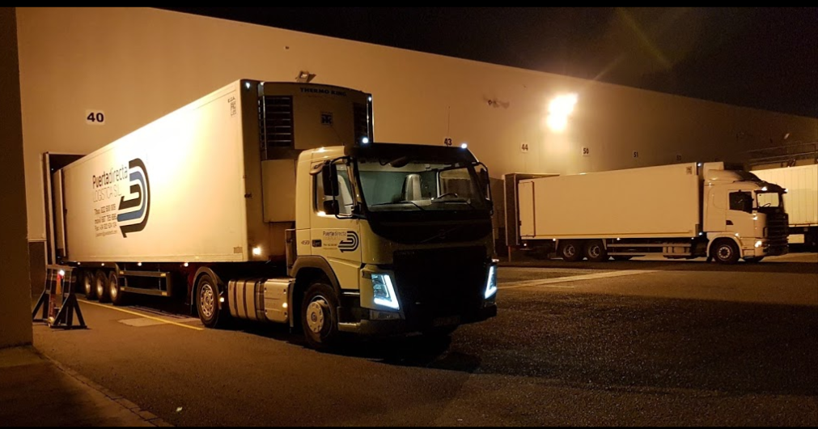
Our Website:
http://puertadirecta.weebly.com

Slide 7
Overall Business Value
Decreased Probability of Human Error
Reduce potential business liability by keeping trucks up to date with inspections
Help achieve customer satisfaction by keeping the entire truck fleet up to date on inspections and maintenance

Slide 8
Any Questions?

Slide 9
Thank you!

